Slide 1
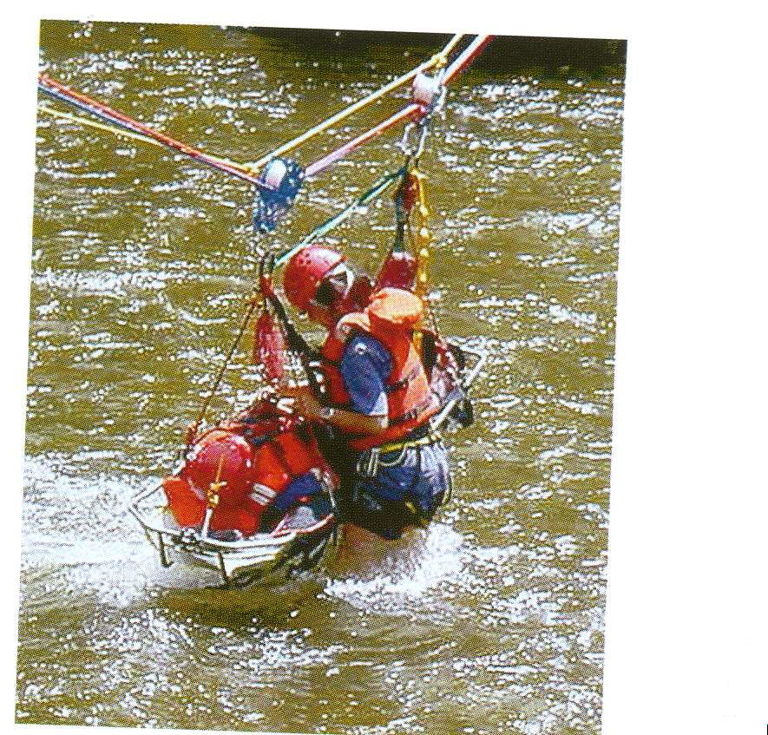
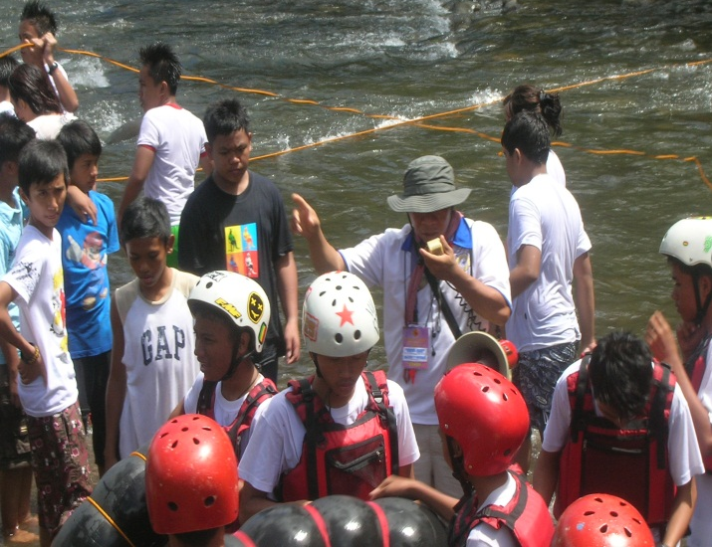

Slide 2
RA No. 10121 - Salient Features
IV. Disaster Volunteers (Sec. 13)
Mobilization of DVs by government agencies, CSOs, private sector and LGUs to augment their respective personnel complement and resource requirement;
Enhancement, welfare and protection of DVs shall be the full responsibility of said agencies;
Maintenance of National Roster of ACDVs, NSRC, CSOs and Private Sector by OCD, list of which shall be submitted through the LDRRMOs

Slide 3
RA No. 10121 - Salient Features
IV. Disaster Volunteers (Sec. 13)
Accreditation to be done at the municipal / city level
DV mobilization to be based on guidelines to be issued by the NDRRMC
Entitlement to compensatory benefits / accident personnel insurance

Slide 4
RA No. 10121 - Salient Features
Integration of DRR Education in School Curricula at the Secondary and Tertiary Levels, NSTP, Sanggunian Kabataan; Mandatory Training in DRR for Public Sector Employees, including formal and non-formal, vocational, indigenous learning and out-of-school youth courses and programs (Sec. 14)

Slide 5
RA No. 10121 - Salient Features
The DepEd, CHED, TESDA, in coordination with OCD, the NYC, DOST, DENR, DILG-BFP, DOH and DSWD and other relevant agencies, shall integrate DRRM education in the school curricula of secondary and tertiary levels of education.
Including the NSTP, whether public or private, also formal and non-formal, technical-vocational, indigenous learning, and out-of-school youth courses and programs;
The N/R/L DRRMCs, the LDRRMOs, the BDRRMCs and the SK councils shall encourage community, specifically the youth, participation in DRRM activities, such as organizing Quick Response Groups, as well as DRRM programs as part of SK Programs and projects.
The Public Sector employees shall be trained in emergency response and preparedness; training is mandatory for such employees.

Slide 6
NDRRM FRAMEWORK
Safer, adaptive and resilient Filipino communities toward sustainable development
Mainstreaming
DRR and CCA in Planning and
Implementation
RISK FACTORS
Hazards
Exposures
Vulnerabilities
Capacities
Prevention & Mitigation
Preparedness
Rehabilitation & Recovery
Response

Slide 7
Diagram Explanation
Because the country is challenged by increasing disaster and climate risks caused by dynamic combinations of natural and human-induced hazards, exposure, and people’s vulnerabilities and capacities…
There is an urgent need for the country to work together through multi-stakeholder partnerships and robust institutional mechanisms and processes so that Filipinos will be able to live in safer, adaptive and disaster resilient communities on the path to developing sustainably.
RISK FACTORS
Hazards
Exposures
Vulnerabilities
Capacities

Slide 8
Diagram Explanation
This DRRM framework indicates the paradigm shift towards a proactive and preventive approach to disaster management.
It emphasizes that resources invested in disaster prevention, mitigation, preparedness and climate change adaptation will be more effective towards attaining the goal of adaptive, disaster resilient communities and sustainable development.

Slide 9
Diagram Explanation
The Framework shows that mitigating the potential impacts of existing disaster and climate risks, preventing hazards and small emergencies from becoming disasters, and being prepared for disasters, will substantially reduce loss of life and damage to social, economic and environmental assets
It also highlights the need for effective and coordinated humanitarian assistance and disaster response to save lives and protect the more vulnerable groups during and immediately after a disaster.

Slide 10
Diagram Explanation
Building back better after a disaster will lead to sustainable development after the recovery and reconstruction process.
The upward motion indicated by the spiraling arrows represents a bottom-up participatory process, enhanced level of awareness, strengthened multi-stakeholder partnerships, and pooling of resources.

Slide 11
Diagram Explanation
Mainstreaming DRR is a means towards
refocusing the development goals, objectives and targets to be able to adequately respond to disaster risks; and
identifying and implementing appropriate interventions to address the impacts of disaster risks.
Mainstreaming DRR is an important step towards avoiding huge losses from disasters.

Slide 12
Diagram Explanation
These processes will synergize efforts and create rippling positive changes toward addressing the underlying causes of vulnerabilities and mainstreaming DRRM in national and local policy-making, planning, investment programming and in the policy/plan implementation.

Slide 13
ANATOMY OF COMMUNITY RISK MANAGEMENT
community
readiness
Community
risk
hazard

vulnerability
multisectoral, all hazards
=
indicators:
indicators:
indicators:
indicators:
probability
scale/magnitude/
strength/intensity
spread
duration
biological hazards:
season, infectivity,
latency, transmission
resistance, etc.
People:
access to health care
measles vaccination
under 5 nutrition
under 5 mortality
access to clean water
access to sanitation
adequate housing
employment/ income
female literacy
Property:
health infrastructure
vehicles
medical supplies
Services:
curative care services
ambulance services
public health services
health info system
Environment:
water/soil/air quality
policy, plans, procedures
knowledge, skills, attitudes
resources
legislation
national & sectoral policy
administrative procedures
response & recovery plans
preparedness plans
technical guidelines
management structure
institutional managements
information systems
warning systems
human resources
material resources
financial resources
simulations & training
education
public information
community participation
research
publications
risk of:
death
injury (mental/ physical)
disease (mental/physical)
loss of life
displacement
loss of property
loss of income
secondary hazards
breakdown in security
damage to infrastructure
breakdown in services
Contamination
natural phenomena
famine
diseases of epidemic
potential
events/crowds
intoxification
infestations
transport accidents
structural failures
industrial accidents
chemical accidents
pollution
refugees
war
terrorism
Prevention & Mitigation
Programme

Vulnerability Reduction
Programme

Emergency Preparedness
Programme
=
Community Risk
Management

Slide 14
PARADIGM SHIFT
FROM REACTIVE TO PROACTIVE MODE
DISASTER RISK MANAGEMENT FRAMEWORK
R = Risk
H = Hazards
V = Vulnerabilities
C = Capacities
R = H x V
C

Slide 19
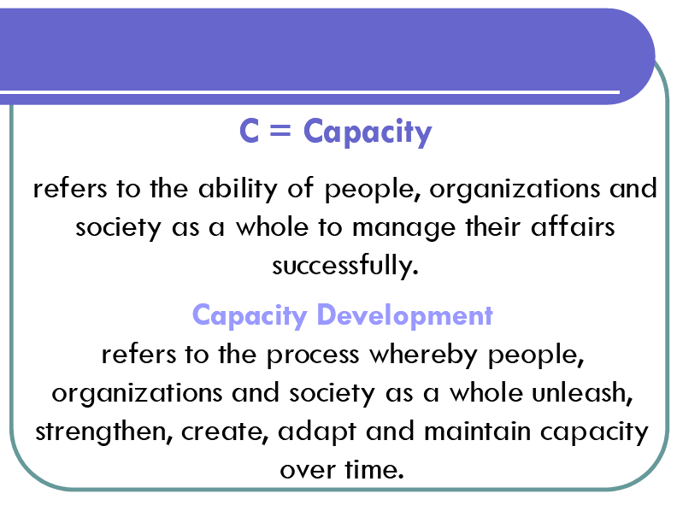

Slide 20
Seven Most Important Terms and Concepts
Hazard Any potential threat to public safety and/or public health | Risks Anticipated consequences of a specific hazard interacting with a specific community (at a specific time)
Emergency An actual threat to public safety and/or public health | Vulnerabilities Factors which increase the risks arising from a specific hazard in a specific community (risk modifiers)
Disaster Any actual threat to public safety and/or public health where local government and the emergency services are unable meet the immediate needs of the community | Capacities An assessment of ability to manage to an emergency (a risk modifier)-total capacity is measured as readiness
Community

Slide 21
RISK MANAGEMENT FRAMEWORK
COMMUNITY
Hazard
Vulnerability
Readiness
Community Risks
Risk initiator
Risk modifier
Risk modifier
Prevention and Mitigation Programme
Vulnerability Reduction Programme
Emergency Preparedness Programme
Community Risk Management
“All disasters are emergencies but not all emergencies are disasters”

Slide 22
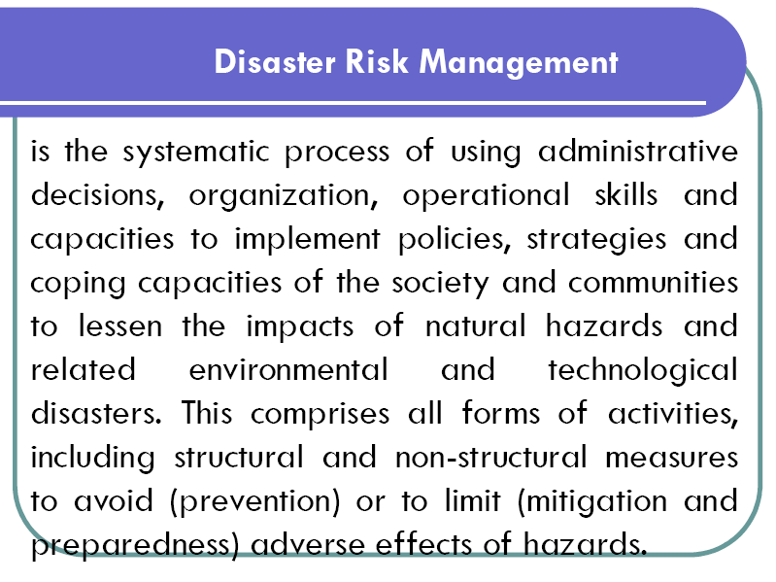

Slide 23
Risk Management is the systematic application of comprehensive tools for an assessment and treatment process which consists of:
the identification of risks
the analysis of their potential effects
the evaluation of options for treatment
the implementation of preventive and/or reactive measures
the effective supervision and repetitive revision of the process
aiming at the elimination and/or reduction of risks to an acceptable calculated level in order to maximize civil protection and public safety in accordance with our mission.

Slide 24
Disaster Crunch Model
UNDERLYING
CAUSES
R = H x V
c
DYNAMIC
PRESSURES
CULTURE,
IDEOLOGIES
D
I
S
A
S
T
E
R
D
I
S
A
S
T
E
R
D
I
S
A
S
T
E
R
UNSAFE
CONDITIONS
STRUCTURES,
POVERTY,
DEPRIVATION
HAZARDS
VULNERABILITIES
RISK
POLITICAL
SYSTEM
PROCESSES,
MACROFORCES (Urban Migration, Environmental Degradation)
ETHNIC
DIVIDE

Slide 25
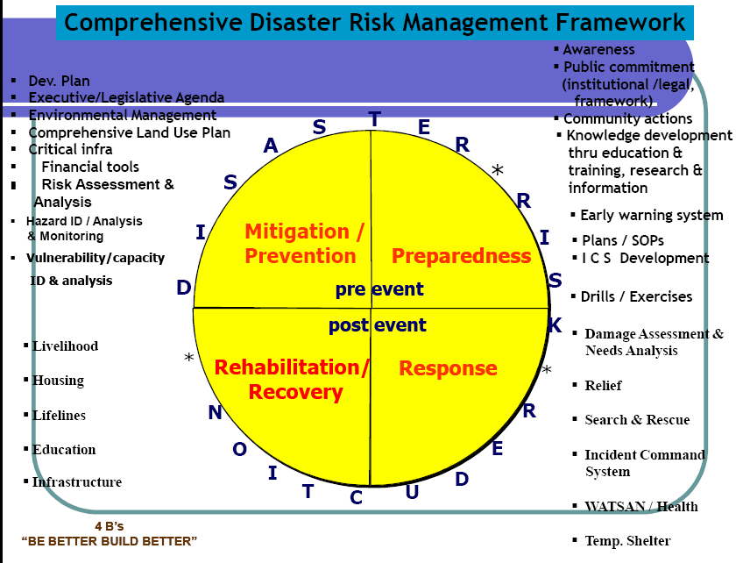

Slide 26
Prevention | Mitigation | Preparedness | Contingency
Activities designed to provide permanent protection from risks or disasters, or reduce the intensity or frequency of a hazardous event so that it does not become a disaster | Measures taken ahead of a crisis incident or disaster aimed at reducing its impact on society and the environment | The ability to predict various emergencies and prepare people to react appropriately during and following such possible events | The ability to rapidly respond to and cope with the effect of specific emergency and achieve people’s readiness to react appropriately
CRISIS MANAGEMENT PLAN

Slide 27
Emphasis on Preparedness
A process that includes the readiness:
To predict and where possible
To prevent risks or disasters
To reduce their impact as well as
To respond to and
To cope with their consequences
CRISIS MANAGEMENT PLAN
(Note: Child Rights-Based Risk Management Policy)
Rapid Assessment
Psychosocial Development
Rights of the Child

Slide 28
SCOPE DEFINITION
HAZARD IDENTIFICATION
Classification ( e.g. landslide, debris flow, rock fall)
Extent and Direction( e.g. location, area, volume)
Movement (e.g. rate: creep, slow, fast)
RISK ANALYSIS
RISK ASSESSMENT
RISK MANAGEMENT
CONSEQUENCE ANALYSIS
Element at Risk
(Property, Roads, Communications, Services and People)
Vulnerability
(Relative Damage,
Probability of Injury, Loss of Life)
HAZARD ANALYSIS
Estimated Frequency and Impact
(Qualitative & Quantitative)
Relate to Initiating Events
(Rainfall, Earthquake, Service Failure, Malfunction and/or Historic Data)
RISK ESTIMATION
RISK ASSESSMENT & MANAGEMENT FRAMEWORK
RISK ESTIMATION
Risk = Hazard x Vulnerability (Capacity)
RISK EVALUATION
Compare to levels of tolerable or acceptable risk; Assess priorities and options
Decision Making (stakeholders)
Technical support (advice)
RESPONSE OPTIONS
Accept risk, Avoid risk, Reduce likelihood, Reduce consequences, Transfer risk
CONTINGENCY PLAN
Detail selected options
RISK CONTROL
IMPLEMENT PLAN
Policy and Planning
MONITOR AND EVALUATE
Risk Changes, More Information, Further Studies

Slide 29
R= H x V c
What is the hazard?
What are the vulnerabilities?
What elements are at-risk?
What constitute capacities?
Which one is the most at-risk?
Cagara
Bocil

Slide 30
Any Question?
THANK YOU VERY MUCH!
BOY SCOUTS OF THE PHILIPPINES
NATIONAL OFFICE • Manila
DISASTER RISK REDUCTION MANAGEMENT TRAINING
Session No. 2 – NDRRM FRAMEWORK
Training Presentation and Resource Material | Program & Adult Resources Development
© copyright 2015 | Boy Scouts of the Philippines | All rights reserved.

